Slide 1

Agile Software Development (TCS 855)
Lean Software Development
Prof.(Dr.) Santosh Kumar
Department of Computer Science and Engineering
Graphic Era Deemed to be University, Dehradun

Slide 2
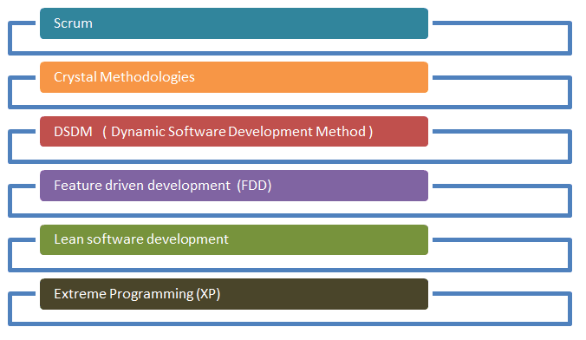
Agile Process Model
Figure: Agile Process Model

Slide 3
Lean Software Development(LSD)
The term lean software development originated in a book by the same name, written by Mary Poppendieck and Tom Poppendieck in 2003
Lean Software Development (LSD) is an agile framework which is used to streamline & optimize the software development process.
Advantages of LSD :
LSD has proved to improve software development in following ways :
LSD removes the unnecessary process stages when designing a software so that it acta as a time saver as simplifies the development process.
With focus on MVP, Lean Software Development prioritizes essential functions so this removes the risk of spending time on valueless builds.
It increases involvement power of your team as more and more members participate due to which the overall workflow becomes optimized and losses gets reduced.

Slide 4
Key Principles of Lean Software Development :
There are 7 established lean principles which comes with a set of tactics, practices and processes that builds more efficient software products :
Eliminating the waste
Fast Delivery
Amplify Learning
Builds Quality
Respect Teamwork
Delay the commitment
Optimizing the whole system

Slide 5
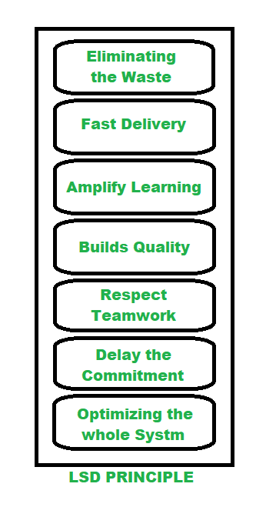
The principles of LSD:
LEAN SOFTWARE DEVELOPMENT (LSD) PRINCIPLE

Slide 6
Eliminating the Waste : To identify and eliminate wastes e.g. unnecessary code, delay in processes, inefficient communication, issue with quality, data duplication, more tasks in log than completed etc. regular meetings are held by Project Managers. Which allow team members point out faults and suggest changes in next turn.
Fast Delivery : Previously long time planning used to be the key success in business, but in passage of time it is found that engineers spend too much time on building complex systems with unwanted features. So they came up with MVP strategy which resulted them to build products quickly that included with a little functionality and launch the product to market and see the reaction. Such approach allow them to enhance product on the basis of customer feedback.
Amplify Learning : Learning is improved through ample code reviewing, meeting that are cross team applicable. It is also ensured that particular knowledge isn’t accumulated by one engineer who’s writing a particular piece of code so paired programming is used.

Slide 7
Builds Quality : LSD is all about prevent waste, keeping an eye on not sacrificing quality. Developers often apply test-driven programming to examine the code before it is written. The quality can also be gained to get constant feedback from team members and project manager.
Respect Teamwork : LSD focuses on empowering team members, rather than controlling them. Setting up a collaborative atmosphere, keep perfect balance when there is short deadlines and immense workload. This method becomes very much important when new members join in a well-established team.
Delay the Commitment : In traditional project management it often happens when you make your application and it turns out to be completely unfit for the market. LSD method recognize this threat and make room for improvement by postponing irreversible decisions until all experiment is done. This methodology always construct software as flexible, so the new knowledge is available and engineers can make improvement.
Optimizing the whole system : lean’s principle allow managers to break a issue to small constituent parts to optimize team’s workflow, create unity among members and inspire a sense of shared responsibility which results in enhancing the team performance.

Slide 8
Weakness in LSD :
Make it scalable as other frameworks since it strongly depends on team involved.
It is hard to keep with pace so it is not easy for developers to work with team members as conflict may occur in between them.
It leads to difficult decision making process as it is mandatory for customers to clearly set their requirements for the development not to be interrupted.

Slide 9
Conclusion
Lean Software Development is one of the proactive approach that drives your body through productivity and cleanliness. It closely connects to Agile methodology, knowledge-sharing experience, fast product delivery. All processes and stags of development are accurately built to deliver the end product at minimum cost in a timely manner.

